Slide 1
Digital Arts Summer Homework/Response
2015-2016

Slide 2
What makes shapes in clouds?

Slide 3
What makes shapes in clouds?
Our minds, as humans, are set to detect and categorize everything that happens around us. We try to understand everything that doesn't make since and desperately seek to define it. This "reflex," if you will, is a large reason why we see patterns, shapes and different forms in a puff of water vapor. This instinct is called "Pareidolia" and is defined as a "psychological phenomenon involving a stimulus (an image or a sound) wherein the mind perceives a familiar pattern of something where none actually exists." That basically means that because our minds are always racing to find familiar objects and shapes, sometimes it will create some out of nothing.

Slide 4
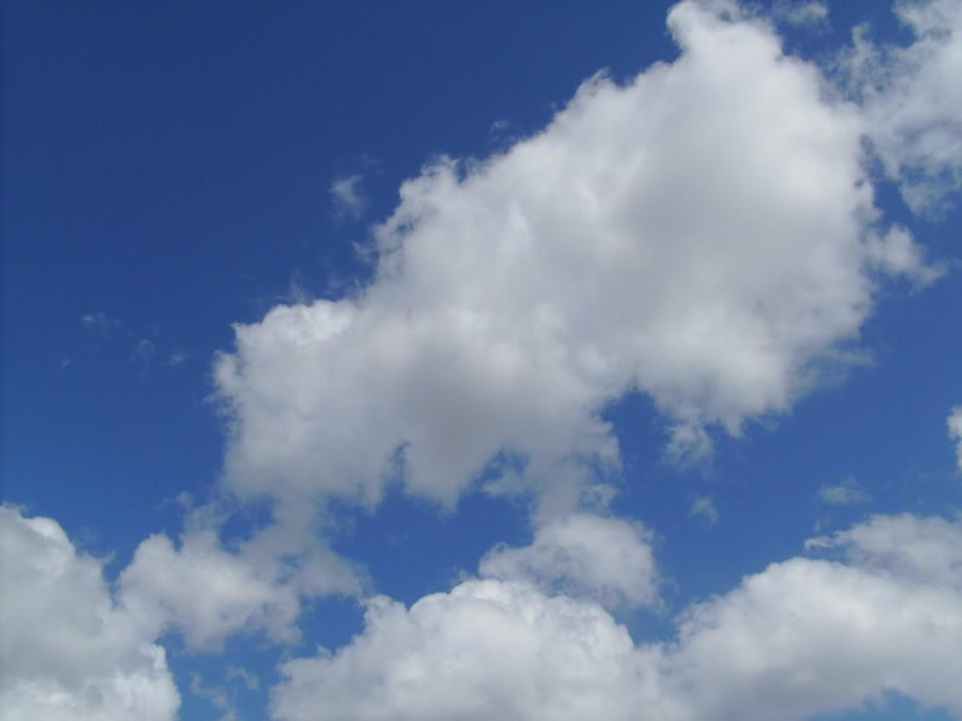
What makes shapes in clouds?

Slide 5
What makes shapes in clouds?
In this photo of a cumulus cloud at midday, many different interpretations could be put forward.

Slide 6
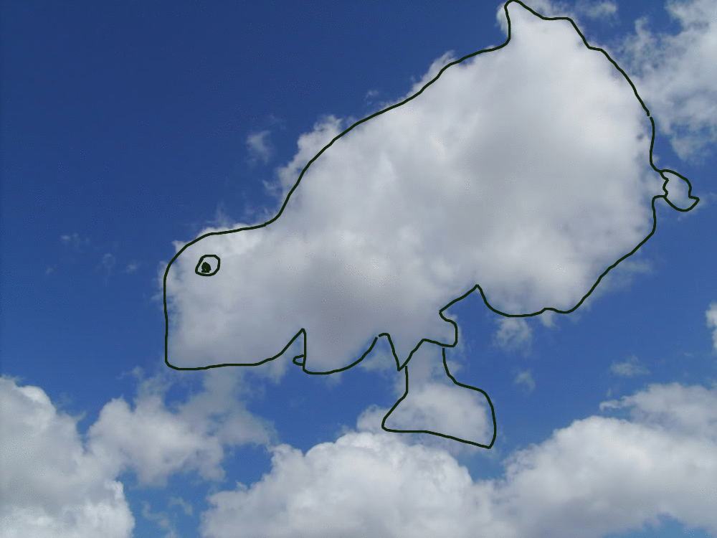
What makes shapes in clouds?
In this photo of a cumulus cloud at midday, many different interpretations could be put forward.
My seven year old neighbor saw it as a monster doing a handstand

Slide 7
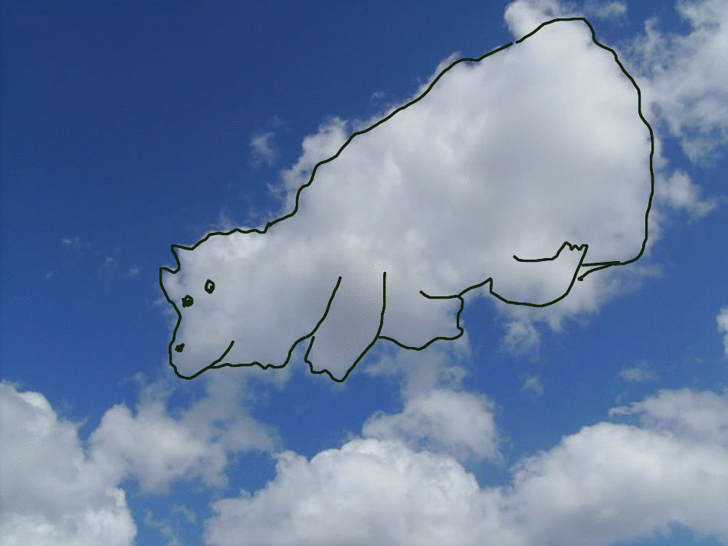
What makes shapes in clouds?
In this photo of a cumulus cloud at midday, many different interpretations could be put forward.
I saw it as a fat dog lying down

Slide 8
What makes shapes in clouds?

Slide 9
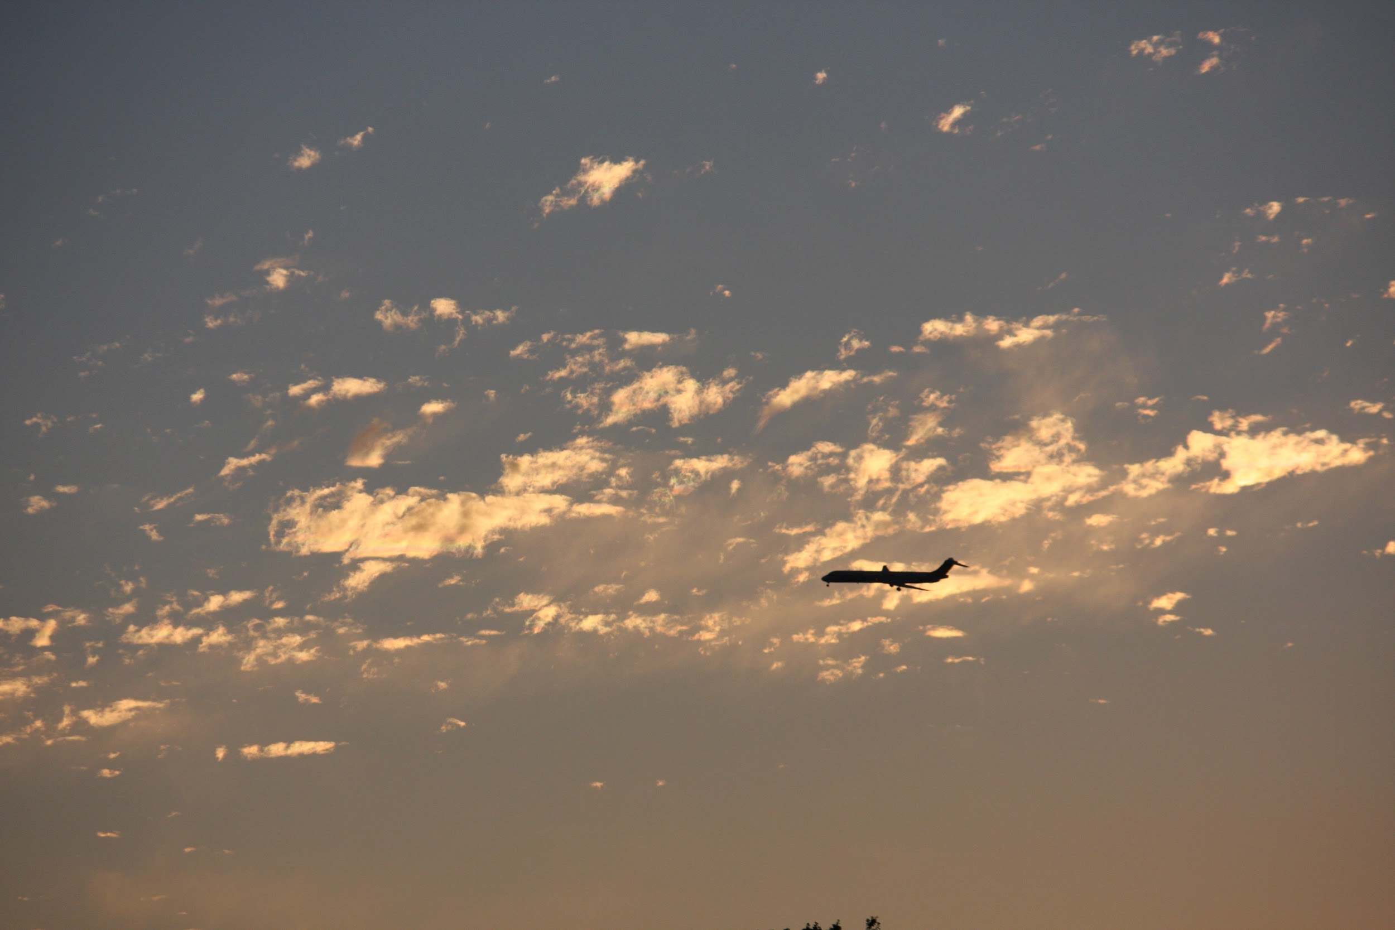
What makes shapes in clouds?

Slide 10
What makes shapes in clouds?
In this photo I took, some clouds could be defined as shapes.

Slide 11
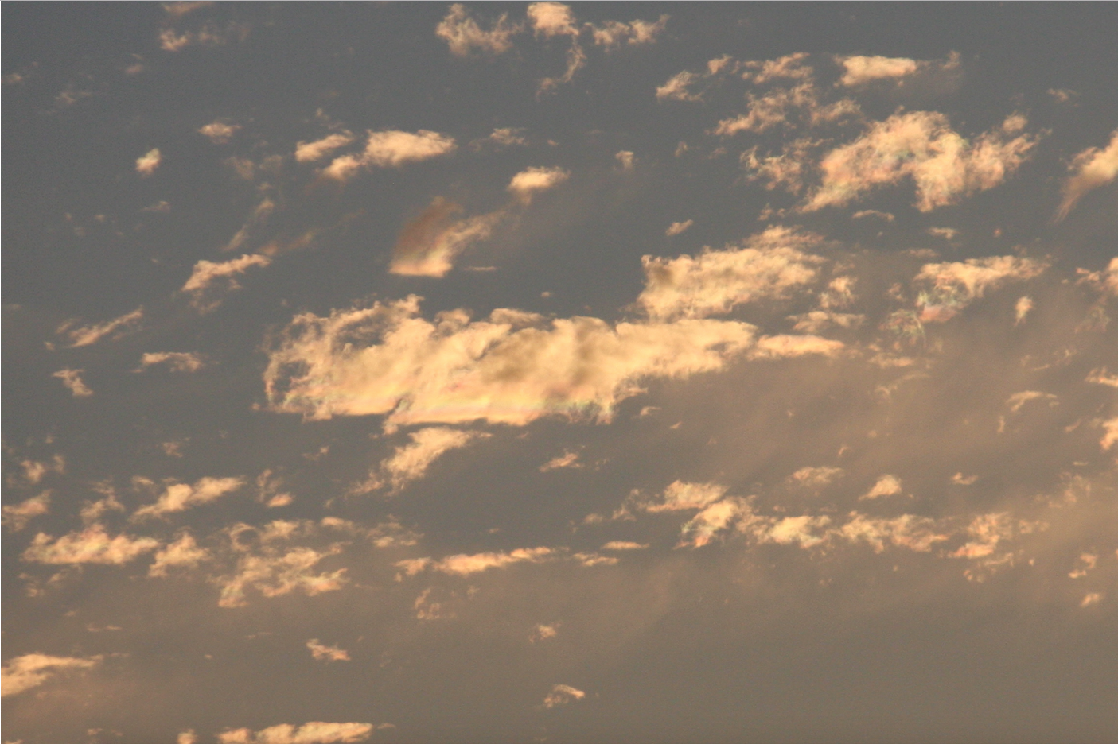
What makes shapes in clouds?
In this photo I took, some clouds could be defined as shapes.

Slide 12
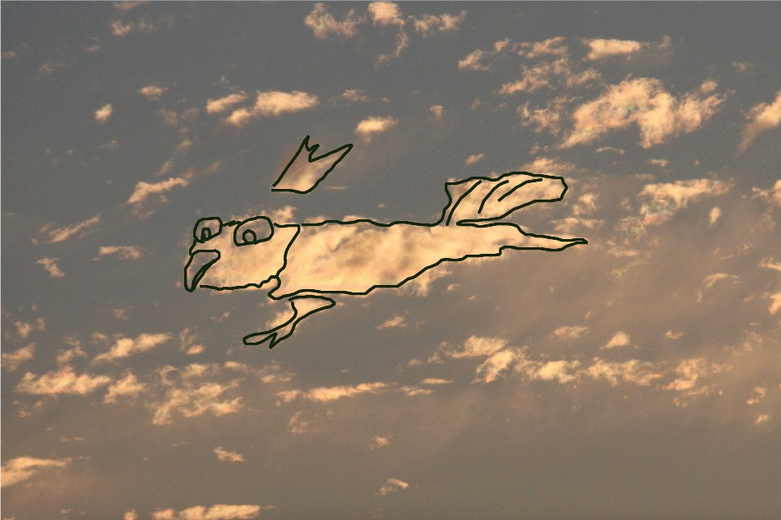
What makes shapes in clouds?
In this photo I took, some clouds could be defined as shapes.
She and I both saw a bird with a crown in this one.

Slide 13
What makes shapes in clouds?
In this photo I took, some clouds could be defined as shapes.
She and I both saw a bird with a crown in this one.

Slide 14
What is the color of water?

Slide 15
What is the color of water?
Well, asking what the color of water is basically is asking what the color of a mirror is, just more complicated. Unlike a mirror, water not only slightly reflects the light hitting it, but also poses as the color behind and to the sides of it. Most people say that the color of water is blue. Well, it that is true, then...

Slide 16
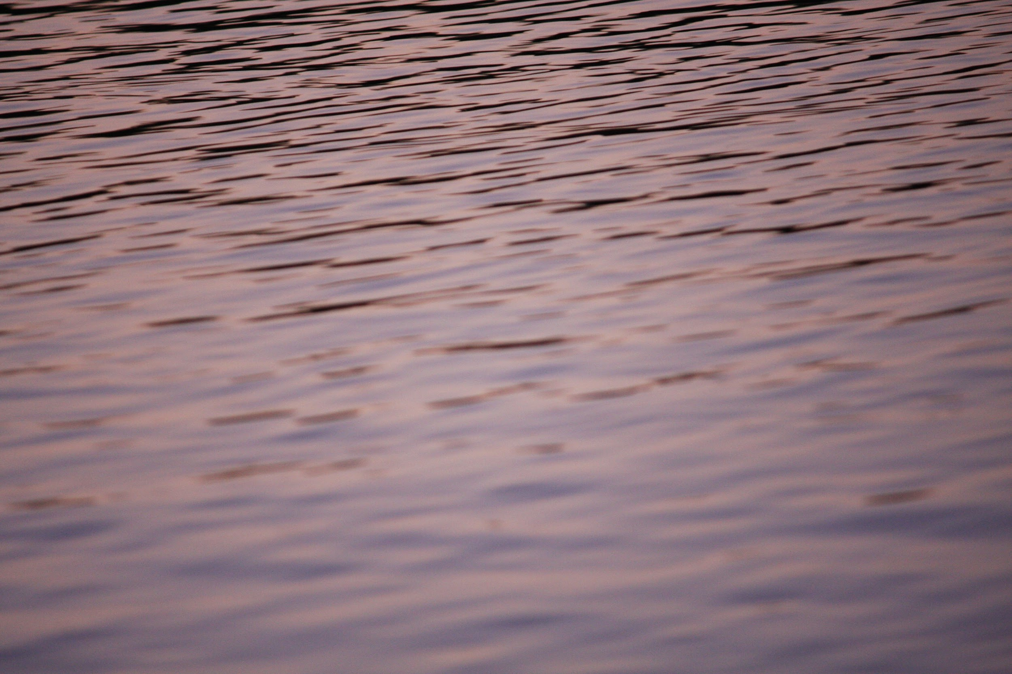
What is the color of water?
then why is it light orange and purple here?

Slide 17
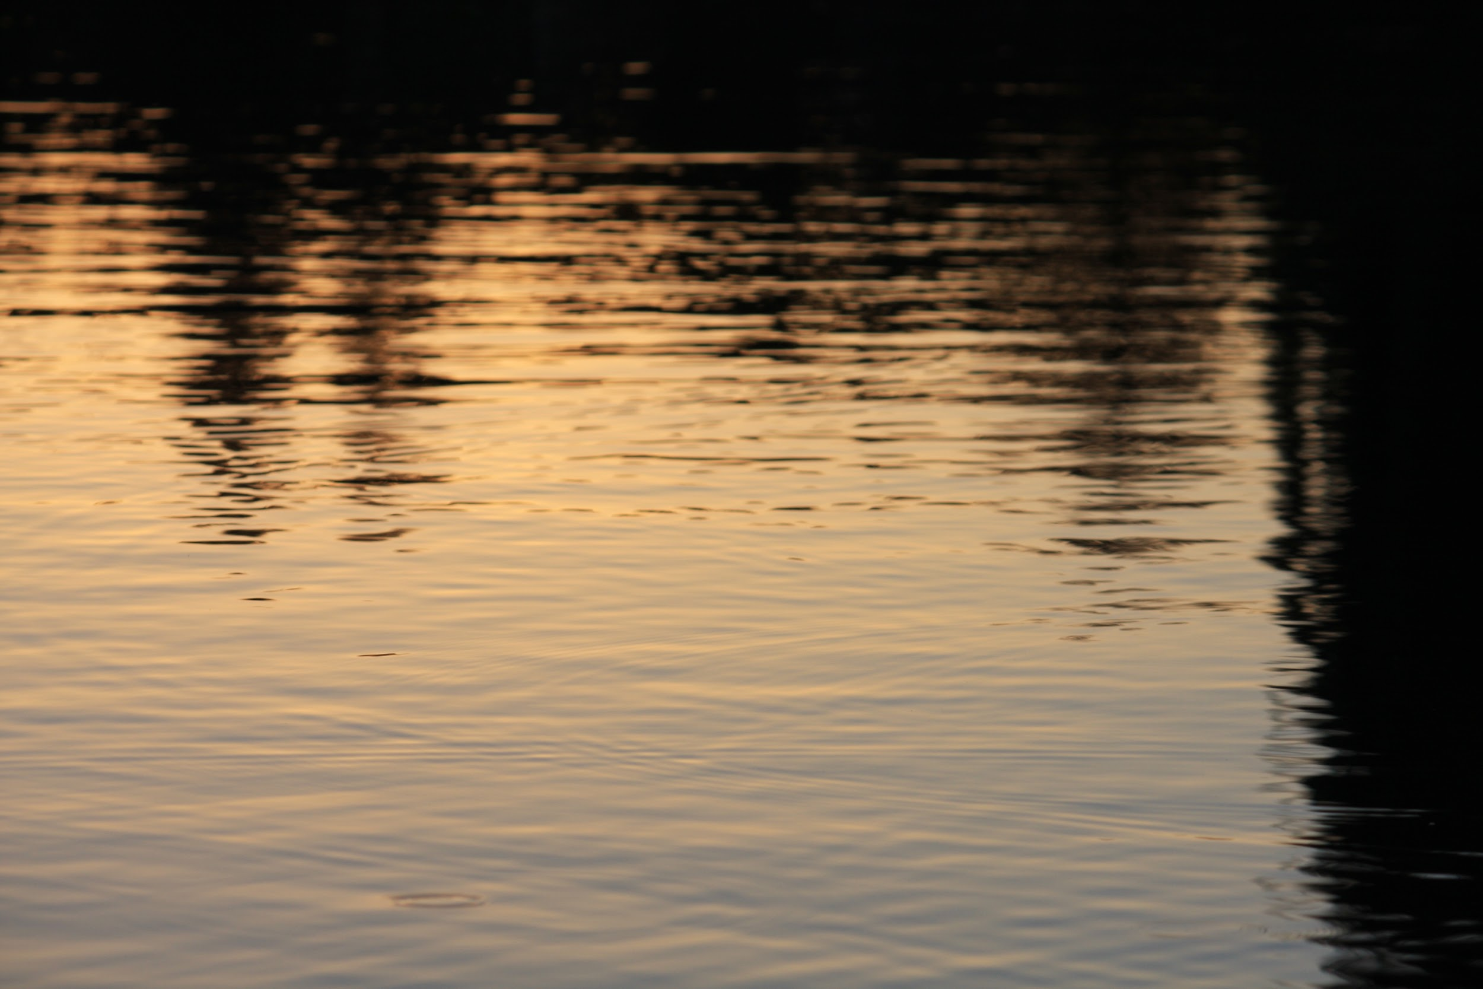
What is the color of water?
then why is it bright orange and cyan with black highlights here?

Slide 18
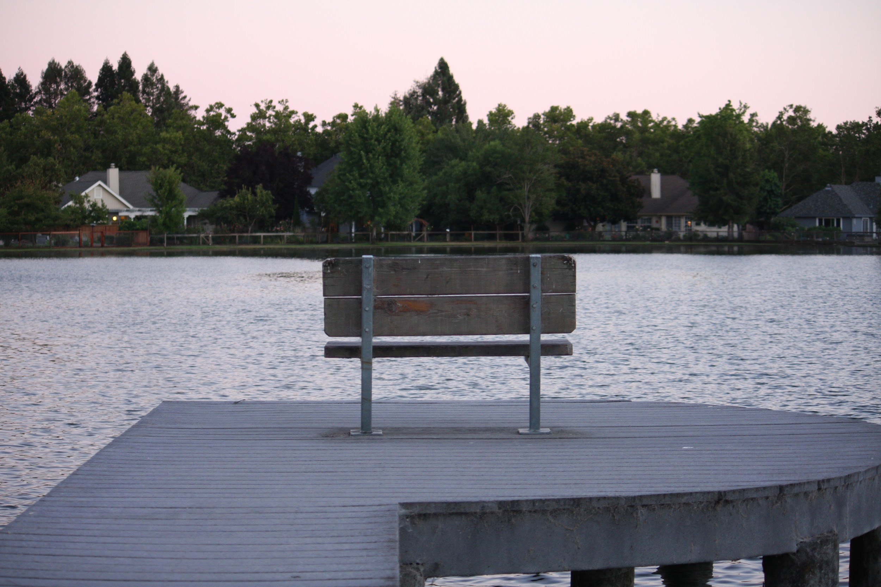
What is the color of water?
With such an ever changing and fast paced world around us, water is never really one color. It is an abundance of colors and light fused into one when a situation calls for it .

Slide 19
~ Fin ~

